Slide 1
Demystifying Clustered Indexes

Slide 2
Links for this Session/Workshop
Scripts and Slide Decks https://github.com/db-berater/partitioning-for-beginners
ERP Demo Database (17.00 GB) https://db-berater.de/downloads/ERP_Demo_2012.bak
SQLQueryStress https://github.com/ErikEJ/SqlQueryStress
Windows Admin Center https://go.microsoft.com/fwlink/?linkid=2220149

Slide 3




Uwe Ricken db Berater GmbH
I am working with IT-systems since early 1990's and with the main focus on Microsoft SQL Server since version 6.0. I started with development of database applications in 1998 with a professional CRM-System based on Microsoft products (Microsoft Office and Microsoft SQL Server).
Since 2008 I'm focused exclusively on Microsoft SQL Server and working in 3rd level support teams for banks, insurances and global industries.
Since May 2013 I am a Microsoft Certified Master: SQL Server 2008 which was an amazing way into the depth of Microsoft SQL Server.
In July 2013 I have been awarded with the MVP Award for Microsoft SQL Server.
www: http://www.db-berater.de
email: uwe.ricken@db-berater.de
blog: http://www.sqlmaster.de
BlueSky: @sqlbambi

Slide 4
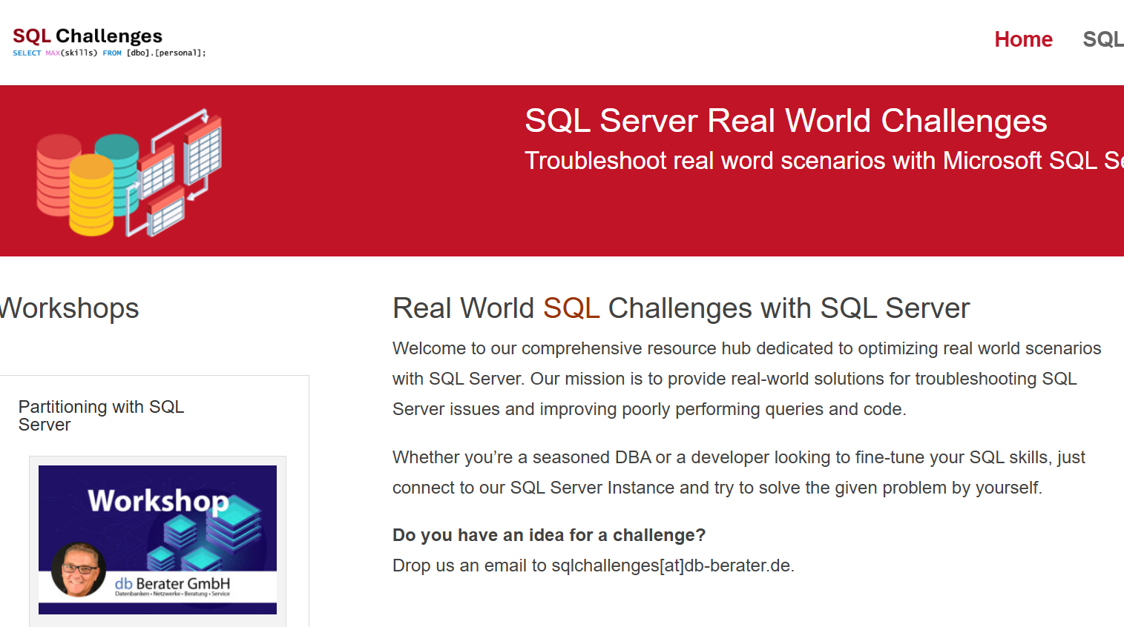
Challenge SQL Server real world scenarios
Get a challenge at least once a month
Connect to a provided SQL Server Instance
Load the challenge scenario
Try to solve it
Blog about your solution
Leave a link in the comments of the challenge to your blog post.
https://sqlchallenges.de

Slide 5
Agenda
Differences between Heap and Clustered Index
What is a HEAP
What is a CLUSTERED INDEX?
Forwarded Record vs. Page Split
Performance Differences
SELECT
INSERT, UPDATE, DELETE
MAINTENANCE

Slide 6
Data Internals
How are your data organized by SQL Server

Slide 7
Data Storage Internals
Every Heap / Clustered Index / Nonclustered Index is a separate storage object.
All have the same internal structure!
HEAP / (non)clustered Index
Partition 1
Partition 2
Partition 3
Partition n
In Row Data
data stored directly within a table's data row (max: 8,060 Bytes)
Out Of Row Data
data stored partially outside of the data row if the row size exceeds
LOB Data
Large text elements / documents / pictures / …
Notes:
000 - Basics about relations indexes partitions allocation units pages etc.sql

Slide 8
Differences between Heap and Clustered Index
What is the better choice for your Workload?

Slide 9
Heaps
Heaps are smart but can have drawbacks

Slide 10
What is a Heap
A heap is a table without a clustered index.
One or more non clustered indexes can be created on tables stored as a heap.
Data is stored in the heap without specifying an order.
Usually, data is stored in the order in which is the rows are inserted into the table, but the Database Engine can move data around in the heap to store the rows efficiently
Data order cannot be predicted! (applies to heaps and indexes!)

Slide 11
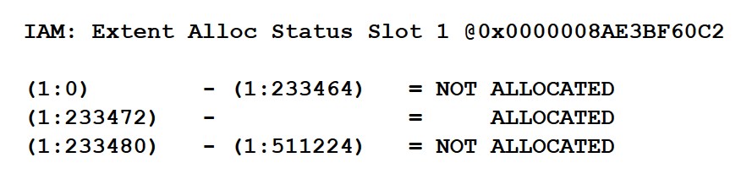
What is a Heap
IAM 110 123 150 151 152
Index Allocation Map
is a special type of page used to track which extents (groups of 8 pages) are allocated to a specific allocation unit within a database file.
Maps the extents used by a table or index within a 4 GB range of a database file.
Leaf 110
(Data)
Leaf 123
(Data)
Leaf 150
(Data)
Leaf 151
(Data)
Leaf …
(Data)
Leaf …
(Data)

Slide 12
Reading data from a Heap
IAM 110 123 150 151 152
The Index Allocation Map must be read first
Microsoft SQL Server must know all Leaf Objects from the underlying table!
When the IAM Page has been loaded into Memory and read, Microsoft SQL Server starts reading the Data Pages.
Usually, the leaf pages will be read by the physical order!
Leaf 110
(Data)
Leaf 123
(Data)
Leaf 150
(Data)
Leaf 151
(Data)
Leaf …
(Data)
Leaf …
(Data)
Process #1
Process #2
Process #2

Slide 13

Reading Data from a HEAP

Slide 14
Inserting data into a Heap
Inserting data into a Heap requires the search for free space on allocated pages:
Search the IAM-Page for allocated data pages
Compare for each allocated page the free space in PFS-Page
If the record fits with its length into an existing data page, it will be inserted
If the record does not fit into an existing data page, a new data page will be allocated
Update PFS-Page if necessary
IAM 110 123 150 151 152
PFS 110: 100% 123: 50% 150 80% 151 100% 152 100%
Leaf 110
Leaf 123
Leaf 150
Leaf 151
80%
50%

Slide 15
Bottleneck of a Heap
The bottleneck of a HEAP table is the PFS Page
The PFS Page tracks the filling grade of each page in a HEAP table!
0% page is empty
50% page is filled UP TO 4.030 Bytes
80% page is filled UP TO 6.424 Bytes
95% page is filled UP TO 7.629 Bytes
100% page is filled up
To much writing on a range of 8.080 data pages can lead to LATCH contention on the PFS Page!
INSERT INTO heap.customers VALUES (250 Bytes);
PFS 100: 0%
0 B in use!
PFS 100: 50%
250 B in use!
4.030 B by calc.
PFS 100: 50%
3.950 B in use!
4.030 B by calc.
PFS 100: 80%
4.950 B in use!
6.424 B by calc.
PFS 100: 100%
8.024 B in use!
8.060 B by calc.
INSERT INTO heap.customers VALUES (3.700 Bytes);
INSERT INTO heap.customers VALUES (1.000 Bytes);
INSERT INTO heap.customers VALUES (1.600 Bytes);

Slide 16
Inserting Data into a HEAP

Slide 17
Clustered Indexes
Don’t trust any recommendation you haven’t checked yourself
NOTE: A clustered index IS the TABLE!

Slide 18
Anatomy of a Clustered Index
Clustered indexes store the data rows in the table/view - based on key values.
The key values ​​are determined by the attributes in the index!
There can be only one clustered index per table, because the data rows themselves can be sorted in only one order.
There can only be ONE clustered index that replaces the HEAP structures
The clustered index is the table itself!

Slide 19
Internal Structure of a Clustered Index
Every Table/Index requires an IAM-Page to identify data pages which belongs to the Table/Index
The Clustered (row based) Index is a “balanced tree”-Index (B-Tree-Index)
Every B-Tree-Index starts with a root node
IAM 110 123 150 151 152
Root Node
Inter med. node
Inter med. node
Inter med. node
Leaf 110
(Data)
Leaf 111
(Data)
Leaf 112
(Data)
Leaf 113
(Data)
Leaf 114
(Data)
Leaf 115
(Data)

Slide 20
Anatomy of a Clustered Index
Root Node
Intermediate Node
Intermediate Node
Intermediate Node
Intermediate Node
Data
Data
Data
Data
Data
Data
Data
Data
Data

Slide 21
Anatomy of a Clustered Index
Level 2
(Id) NULL – 2500 2501 – 5000
5001 – 7500
Level 1
NULL - 2500
2501 – 5000
5001 – 7500
7501 – 10000
Level 0
1.234
2109
2487
2700
4999
5145
7345
7890
9999

Slide 22
Anatomy of a Clustered Index
Level 2
SELECT * FROM dbo.Customers
WHERE Id = 2109;
(Id) NULL – 2500 2501 – 5000
5001 – 7500
Level 1
NULL - 2500
2501 – 5000
5001 – 7500
7501 – 10000
2487
4999
4999
7345
1.234
2109
2700
5145
7345
9999
Level 0
5145
7890

Slide 23
Anatomy of a Clustered Index
Level 2
SELECT * FROM dbo.Customers
WHERE Id = 8091;
(Id) NULL – 2500 2501 – 5000
5001 – 7500
Level 1
NULL - 2500
2501 – 5000
5001 – 7500
7501 – 10000
2487
4999
7345
1.234
2109
2700
5145
7345
9999
Level 0
5145
7890

Slide 24
CLUSTERED vs. HEAP: SELECT
A HEAP uses ALWAYS a TABLE SCAN, because no Index is available!
A SELECT on a CLUSTERED KEY is more efficient, because an INDEX SEEK can access the search predicate(s) directly.
Primitive groupings are more efficient in a HEAP because only leaf pages need to be scanned.
A CLUSTERED INDEX has to scan the B-Tree, too.

Slide 25
Clustered vs. HEAP: NON-Clustered Index
A NON-Clustered Index in a HEAP stores the RID (Row Locator Id) as pointer
The RID consumes 8 Bytes
A REBUILD of the table includes a REBUILD of ALL NON-Clustered Indexes, because the location of the new record may change (new RID).
A NON-Clustered Index in a Clustered Index contains the Clustered Key as pointer
The size of the pointer depends on the data type and the uniqueness of the clustered key
The REBUILD of a Clustered Index does not imply a rebuild of the NON-Clustered Index

Slide 26
RID-Lookup vs. Key-Lookup
Lookups will be used to retrieve values from the table which are not part of the index.
RID-Lookups produce only ONE I/O if no Forwarded Record is affected!
Key-Lookups produce I/O depending on the depth of the index

Slide 27
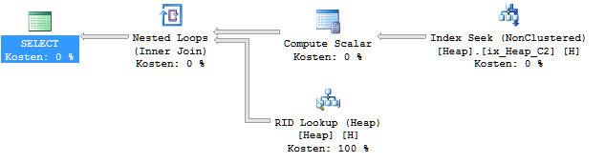
RID Lookup
Demo-Time

Slide 28
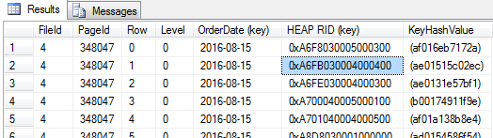
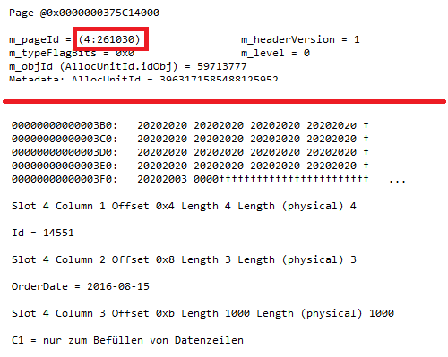
RID-Lookup in Heap
RID: 0xA6FB030004000400
PAGE: 0xA6FB0300
File: 0x0400
Slot: 0x0400
RID: 0xA6FB030004000400
PAGE: 261030
File: 4
Slot: 4

Slide 29
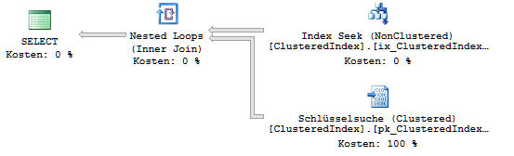
Key Lookup
The costs for a key lookup depend on the depth of the clustered index structure.
As more records are in the table as deeper can the B-Tree structure be.

Slide 30
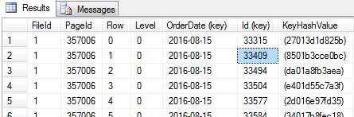
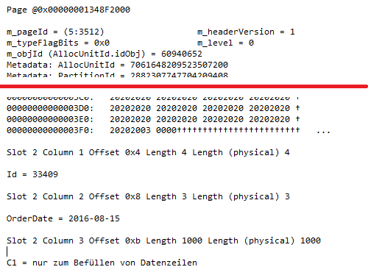
Key-Lookup in clustered index
Root
127
352
353
353
3510
3511
3512

Slide 31
HEAPS: Forwarded Records
Forwarded Records can only occur in HEAPS!
A Forwarded Record will be generated if a record with variable length does not fit on the page after an update.
Demo-Time

Slide 32
Heaps: Forwarded Records
IAM
119
121
126
127
142
156
IAM will be read!
Record on page 119 points to „Forwarded Record“ on page 156
After page 156 has been read the scan operation will continue on page 119
Reading page 121, 126, 127, 142, 156
Page 156 will be read 2 x!
1
119
1 = 156 2 3 4
121
5 6 7 8
126
9 10 11 12
127
13 14 15 16
142
17 18 19 20
156
1
3
4
5
6
7
2

Slide 33

Forwarded Records

Slide 34
Clustered Index: Page Split
Orders 1 – 50
Orders 51 - 100
Orders 101 - 150
Orders 500.001 - …
Orders …
UPDATE dbo.Orders SET Order Text = 'A very long Text' WHERE Order_Id = 37;
Orders 1 – 36
Orders 51 - 100
Orders 101 - 150
Orders 500.001 - …
Orders …
Orders 37 - 50

Slide 35
Actions of Page Split
LOP_BEGIN_XACT
LOP_INSYSXACT LCX_INDEX_INTERIOR Mark index page as part of system transaction
LOP_INSYSXACT LCX_CLUSTERED Mark leaf page as part of system transaction
LOP_INSYSXACT LCX_CLUSTERED Mark NEXT leaf page as part of system transaction
LOP_MODIFY_ROW LCX_PFS Set the value of free space in PFS
LOP_HOBT_DELTA Increase the value for the amount of data pages
LOP_FORMAT_PAGE LCX_HEAP Zero the new page
LOP_INSYSXACT LCX_CLUSTERED Mark new created page as part of system transaction
LOP_INSERT_ROWS LCX_CLUSTERED Insert data on the new page
LOP_DELETE_SPLIT LCX_CLUSTERED Remove the data from the original page
LOP_MODIFY_HEADER LCX_HEAP Set [NEXT PAGE] on original page
LOP_MODIFY_HEADER LCX_HEAP Set [PREVIOUS PAGE] on original page
LOP_INSERT_ROWS LCX_INDEX_INTERIOR Update of the root page / B-tree level
LOP_INSYSXACT LCX_CLUSTERED Release NEWLY added leaf page as part of system transaction
LOP_INSYSXACT LCX_CLUSTERED Release OLD next page as part of system transaction
LOP_INSYSXACT LCX_CLUSTERED Release NEW next page as part of system transaction
LOP_INSYSXACT LCX_INDEX_INTERIOR Release B-Tree as part of system transaction
LOP_COMMIT_XACT

Slide 36
High concurrency systems

Slide 37
Scenario
three tables
dbo.numeric_table with an IDENTITY() clustered index
dbo.guid_table with a random GUID() clustered index
dbo.heap_table with no clustered index
One stored procedure as a wrapper
Inserts 1.000 records in each table
The source table depends on the parameter @table_name

Slide 38
Clustered Index – IDENTITY()
R
I
I
I
L
L
L
L
L
L
L

Slide 39
Clustered Index – random
R
I
I
I
L
L
L
L
L
L
L

Slide 40
Insert IDENTITY Values…
CPU 0
1
5
3
9
CPU 1
IDENTITY-VALUES (POOL)
10
50
14
2
4
11
7
CPU 2
34
67
25
CPU 3
38
79
48

Slide 41
THANK YOU!
I am looking forward for your feedback!
Uwe Ricken

